Slide 1



Digital Logic Design
Semester II
FY
Course Code
316U06C203
Jan – May 2026

Slide 2
5. Foundations of Digital Design

Slide 3
Contents
5.1 Introduction to Synchronous Machine (Mealy and Moore): Block diagram level. And its representation as state diagram.
5.2 Introduction, realization of logic expressions with PROM, PLA and PAL and their implementation.

Slide 4
5.1 Introduction to Synchronous Machine (Mealy and Moore): Block diagram level. And its representation as state diagram.

Slide 5
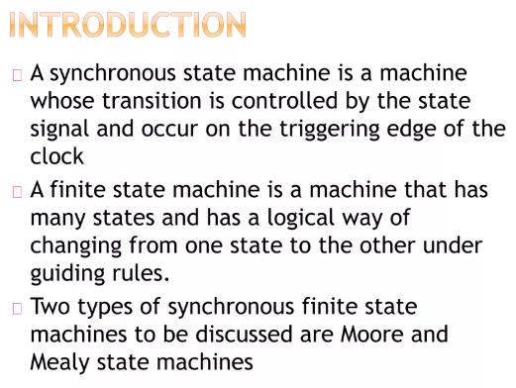

Slide 6
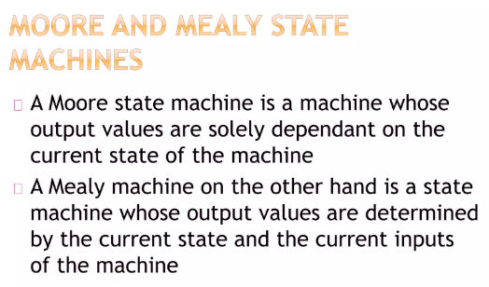

Slide 7
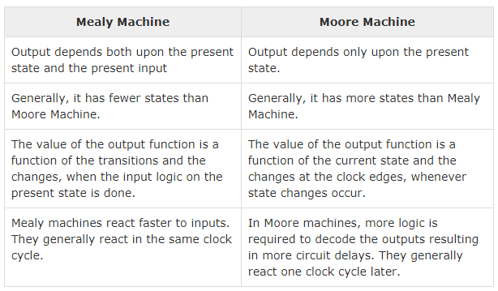

Slide 8
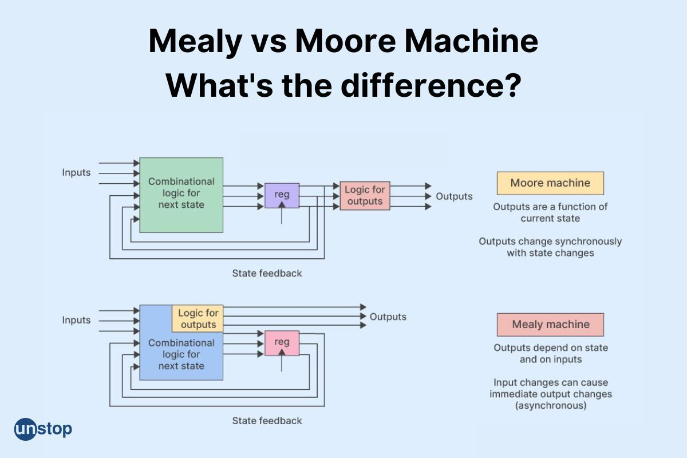

Slide 9
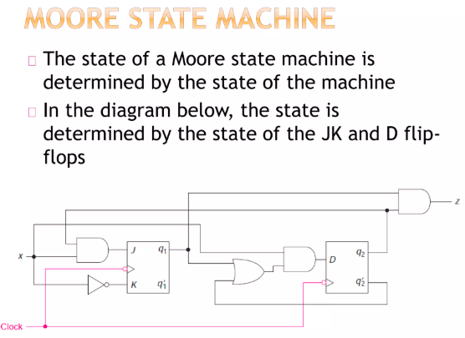

Slide 10
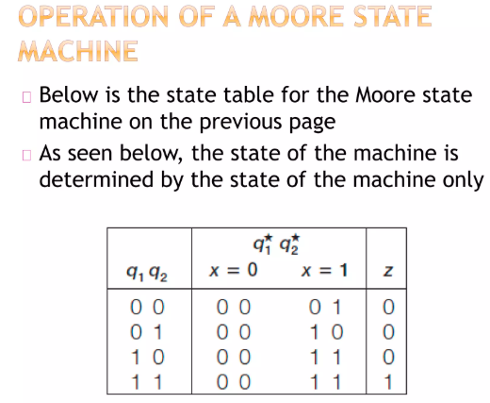

Slide 11
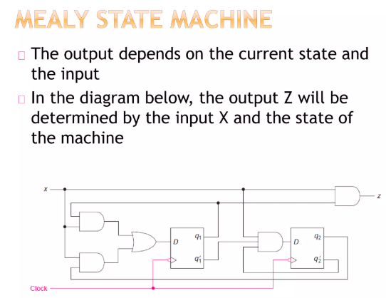

Slide 12
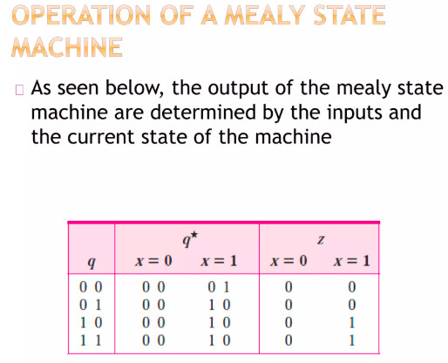

Slide 13
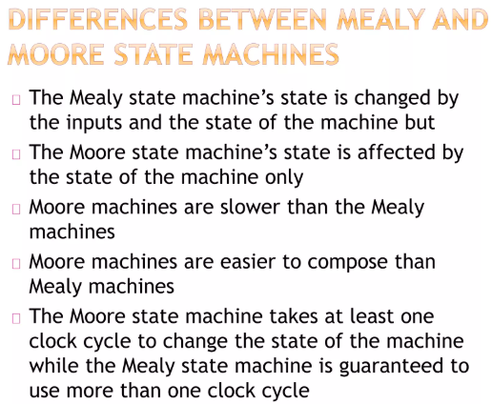

Slide 14



Slide 15
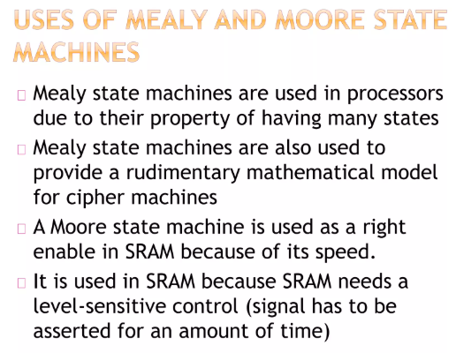

Slide 16
Programmable Logic Array vs Programming Array Logic

Slide 17
Programmable Logic Array (PLA) and Programmable Array Logic (PAL) are both programmable logic devices (PLDs) used to implement combinational logic circuits, but they differ mainly in flexibility, speed, and structure.
Programmable Logic Array (PLA)
Both AND array and OR array are programmable.
Highly flexible (can implement any SOP expression)
Allows sharing of product terms
More complex design
Slower compared to PAL
More expensive
Inputs → Programmable AND gates → Programmable OR gates → Output
It is efficient when many outputs share common terms

Slide 18
Applications of PLA
Custom Reasoning Arrangement: PLAs are used to make exceptionally mechanized reasoning circuits for unequivocal capacities, habitually in embedded structures and purchaser devices.
Prototyping: Draftsmen use PLAs to demonstrate and test reasoning plans before zeroing in on ASIC or FPGA plans.
Estimation Execution: They can complete complex computations in hardware, such as encoding/unraveling plans or custom data dealing with computations.
Modernized Circuit Unraveling: PLAs develop the arrangement of puzzling high-level circuits by allowing fashioners to design Boolean capacities directly into gear.
Control Structures: Used in control systems for programmable state machines and to complete unambiguous control reasoning.

Slide 19
Programmable Array Logic (PAL)
AND array is programmable, OR array is fixed.
Less flexible than PLA
Faster operation
Simpler design
Cheaper and widely used
Inputs → Programmable AND gates → Fixed OR gates → Output
Limited number of product terms per output
PLA → Like a fully customizable kitchen (you can design everything)
PAL → Like a modular kitchen (some parts are fixed)

Slide 20
Programmable Logic Array vs Programming Array Logic
Feature | PLA | PAL
AND Array | Programmable | Programmable
OR Array | Programmable | Fixed
Flexibility | High | Medium
Speed | Slower | Faster
Cost | Expensive | Cheaper
Complexity | High | Low
Product Terms | Shared among outputs | Fixed per output
Design Ease | Difficult | Easy

